Slide 1
Planetary Data from the Kepler mission
By Samantha Petrovich
CMSE 201 Section 002

Slide 2
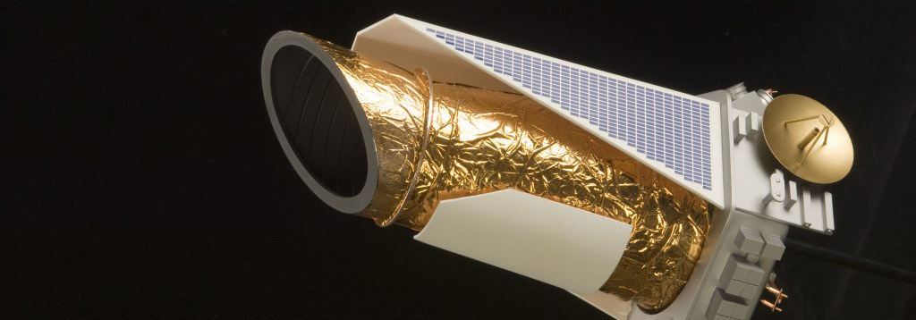
Motivation and background
The discovery of exoplanets is a very new field in astronomy and since I been taught a lot about it in my astronomy classes, I have a higher interest in that specific field.
The Kepler mission Lasted around 10 years and the telescope was decommissioned last year in November.
Notes:
hhh

Slide 3

Something to point out
There is bias in the data that is being presented. What do I mean by that? Well there are probably many planets out in space that have much longer orbital periods that the ten-year mission of Kepler.
For example, Jupiter takes around 11 years to orbit the sun. Saturn takes even longer to orbit.

Slide 4
What type of data did I look at and what were my methods?
The data tables that I did most of my analysis on was from the NASA exoplanet archive. Thankfully, the data that they have is public knowledge, so it is much easier to obtain.
The files that I used were just basic CSV files, so they were easy to work with. The methods that I used were using Pandas, numpy, matplotlib, and seaborn to analyze the data and make my plots.

Slide 5
Three Questions to be answered
What was the most commonly used method to find exoplanets and how accurate are the methods?
What is the average number of exoplanets in an interstellar solar system?
What is the most common type of planet and the most common type of solar system?

Slide 6
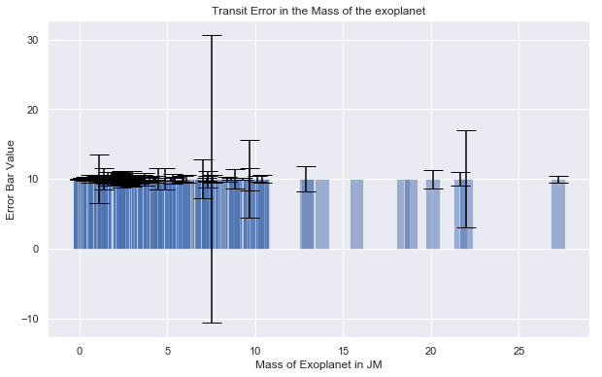
The Transit Method
This is the most common method that is used to find exoplanets and had the smallest error bars.

Slide 7
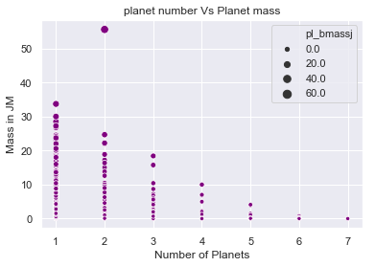
Average Number of Planets in a System
When calculated, the average number of planets came out to be 1.775 planets.

Slide 8
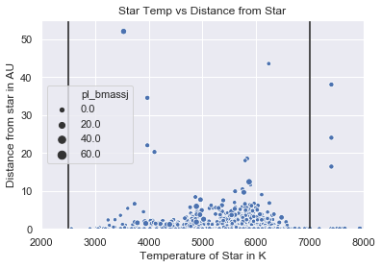
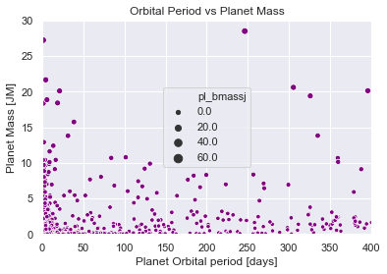
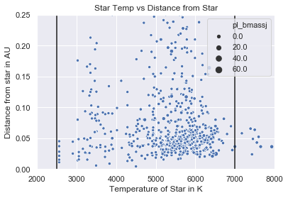
Most common planet and Solar system
From the data it does show that there is a significant number of Planets that are as big as or larger than Jupiter.
The data also shows that the orbits of the planets are quite short and close to their host star.

Slide 9

Questions?

